Slide 2
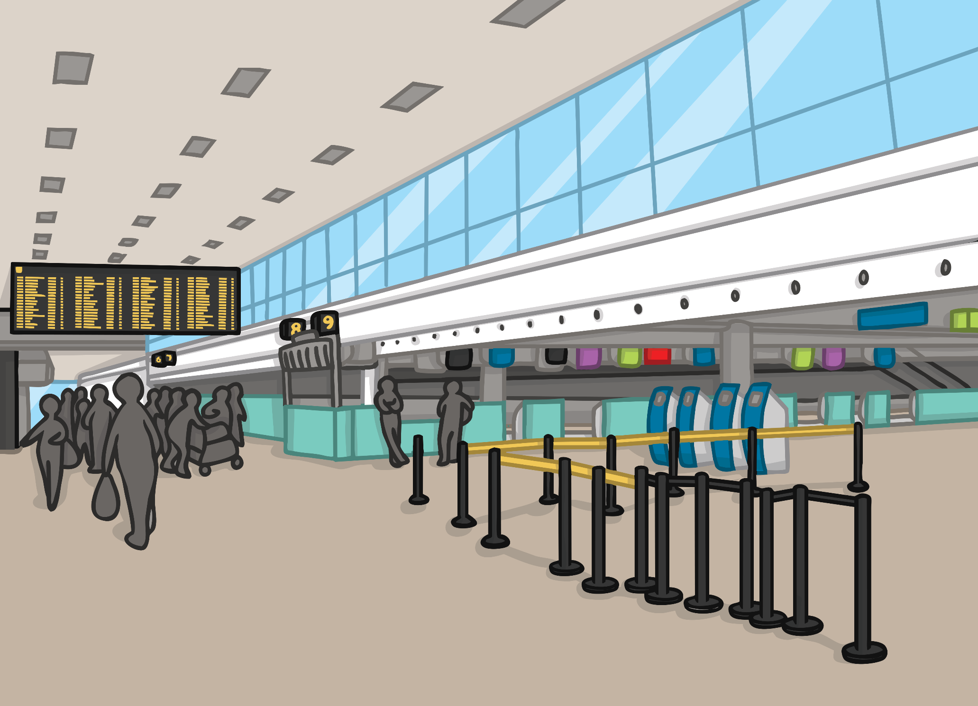
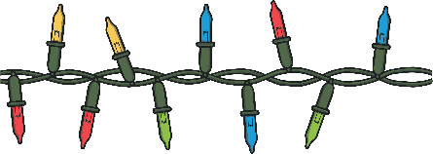
Click each day to find out how Christmas
is celebrated around the world.
10
2
23
4
24
7
15
3
9
8
12
17
5
13
25
19
14
20
6
1
16
11
22
18
21

Slide 3

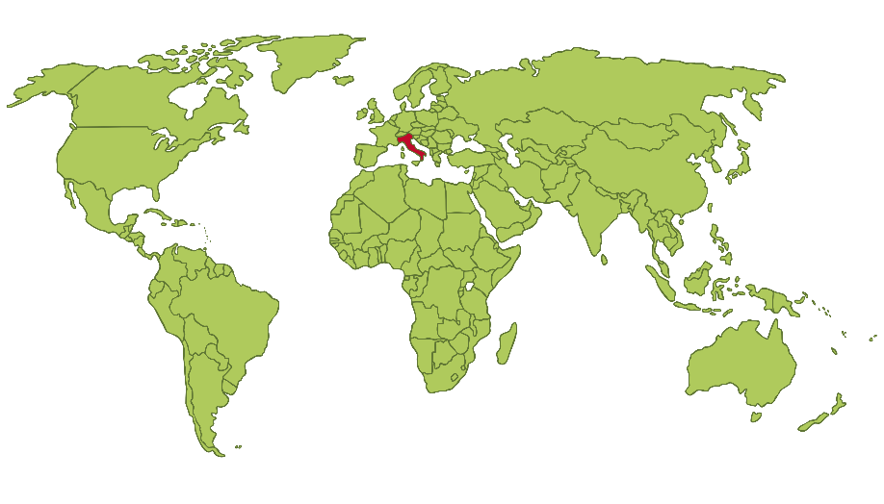
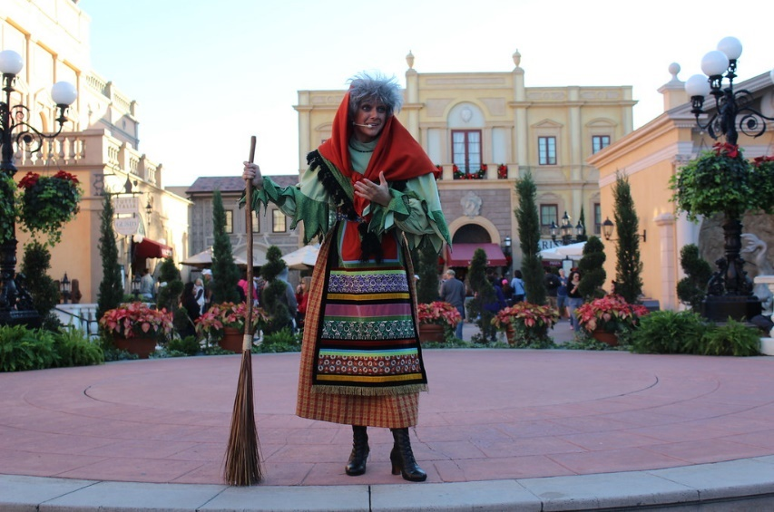
1
On the evening of 5th January,
the night before Christians believe
the wise men gave their gifts to
baby Jesus, La Befana comes to
visit Italian children.
The story goes that she never managed to find the baby Jesus
so leaves His gifts for other
children instead.
She flies around on a broomstick,
enters the house through the chimney, fills children’s stockings with sweets and presents and leaves a lump of coal for children who need to think about their behaviour.
Untitled by Theme Park Tourist is licensed under CC BY 2.0
Back to Calendar

Slide 4

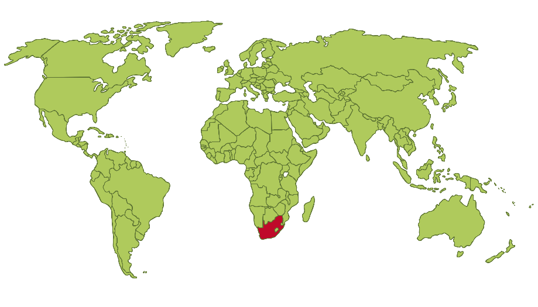
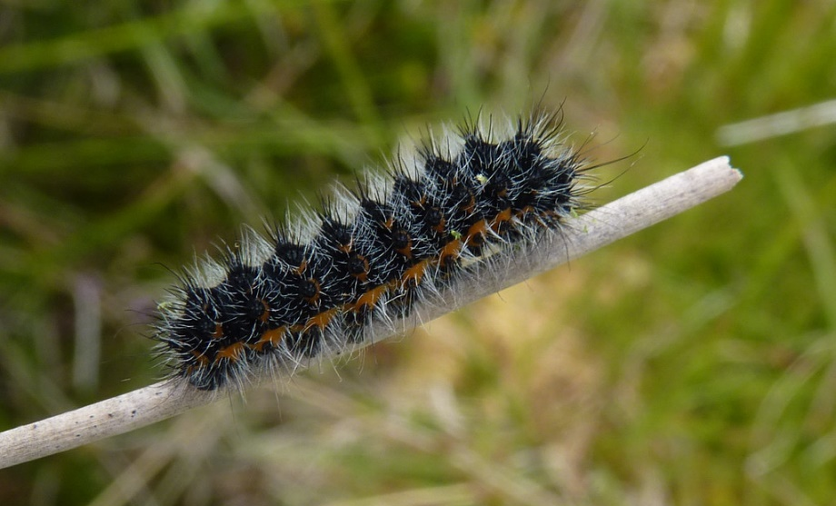
2
On Christmas Day in South Africa, it is not uncommon to find deep fried emperor moth caterpillars on the table ready to be eaten as part of the festive feast.
These surprisingly nutritious critters are a good source of protein and have a flavour similar to tea.
“Emperor Moth caterpillar” by Odd Wellies is licensed under CC BY 2.0
Back to Calendar

Slide 5

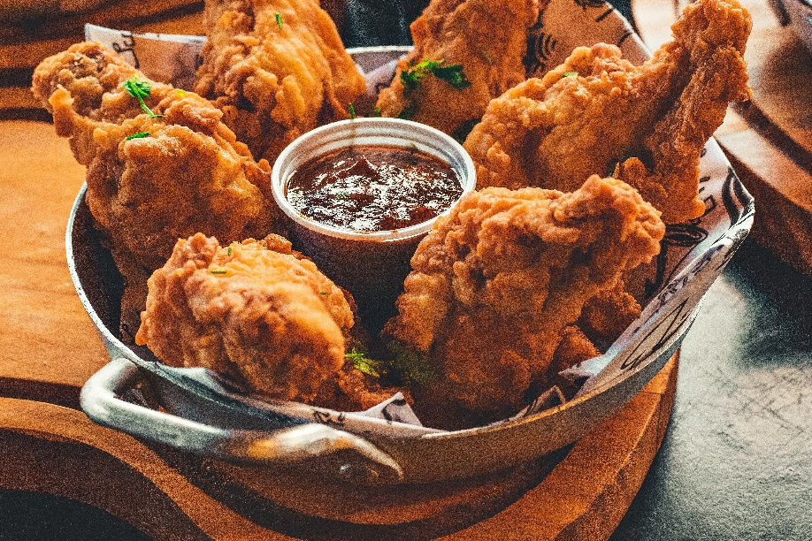
3
Japan does not have as many Christians as other countries of the world so Christmas is not recognised as a religious holiday. In the last few decades, though, some traditions of sending cards and exchanging gifts have become more popular in Japan. Christmas in Japan is seen as a time to spread happiness and Christmas Eve is a time for couples to have a romantic dinner together.
An advert in 1974 made fried chicken a popular choice for Christmas Day dinner and it remains a really busy time for fast food chicken restaurants! Japanese Christmas cake is usually a sponge decorated with strawberries and
whipped cream.
Back to Calendar

Slide 6
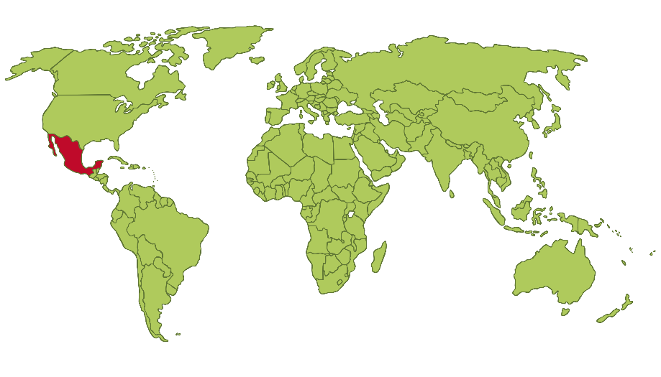
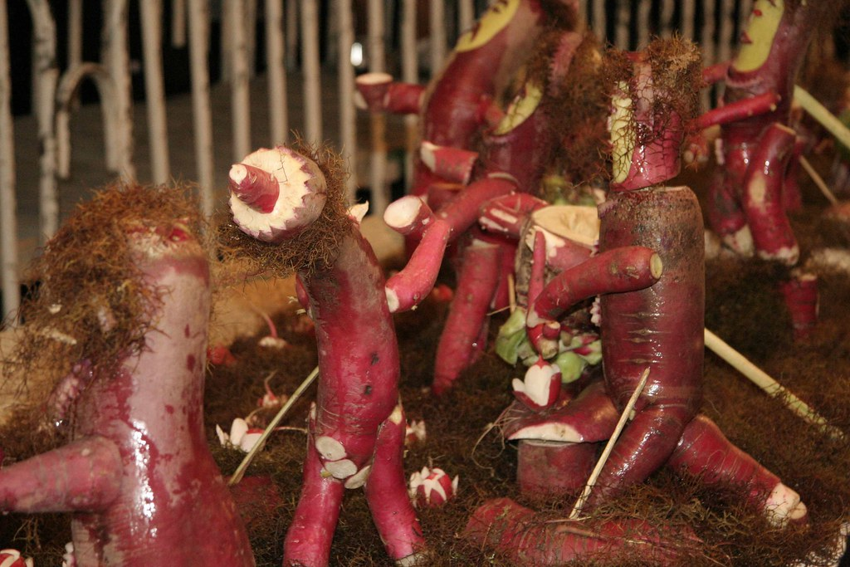
Mexico
4
Noche de Rabanos - The Night of the Radishes - takes place on 23rd December.
Over a century ago, merchants wanting to attract customers on their way to Christmas church services would carve intricate patterns into radishes. The radishes were a success and locals bought the most intricate offerings for their Christmas centrepieces.
In 1897, the then-mayor of Oaxaca declared 23rd December as the official Night of the Radishes.
“Noche de rabanos” by laura ramos is licensed under CC BY 2.0
Back to Calendar

Slide 7

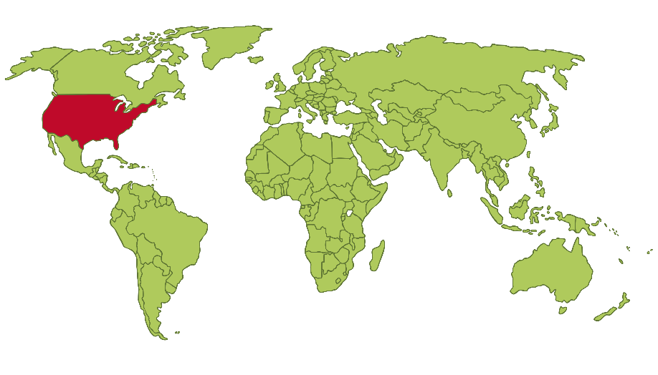
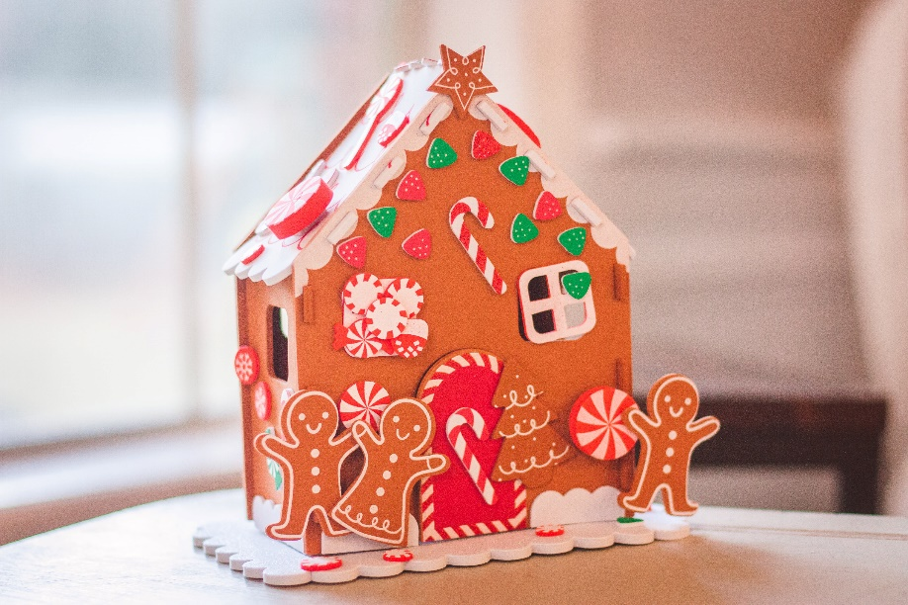
5
There are lots of different Christmas traditions in the multicultural country of the United States.
Popular Christmas activities include making gingerbread houses, going to church, sending Christmas cards and singing carols.
An annual pickle festival is also held in Michigan to celebrate the tradition of hanging a pickle ornament on the Christmas tree - whichever child is first to find the pickle gets a present in return.
Back to Calendar

Slide 8
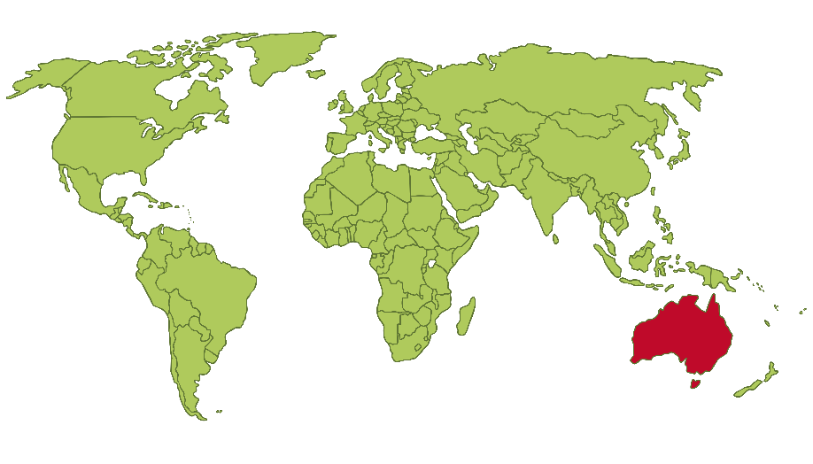
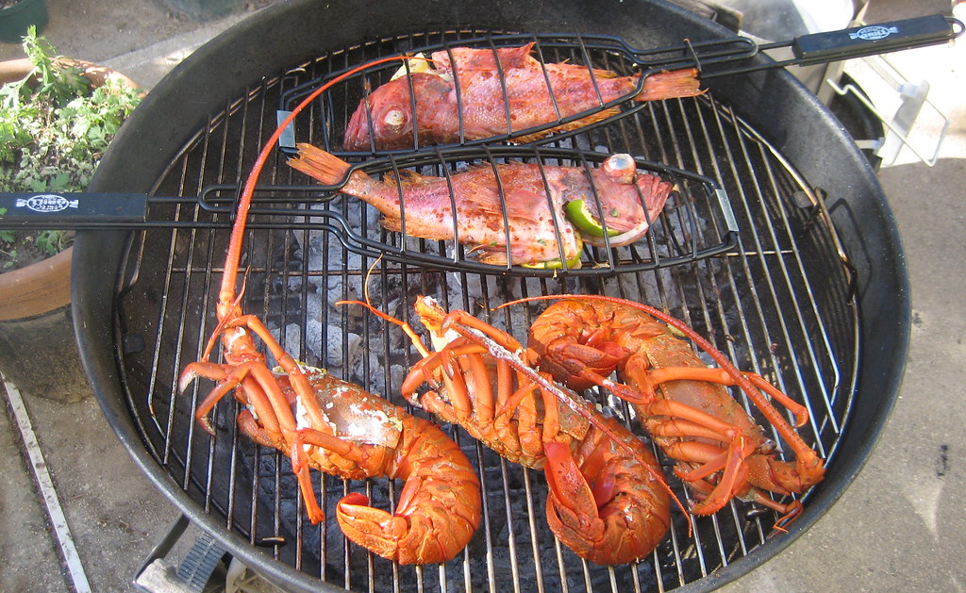
6
Christmas is celebrated in Australia on 25th December but at this time of year, it’s the beginning of summer in Australia.
Some Australians may go to church to sing carols - though the words relating to winter and snow might be changed - and Carols by Candlelight services are broadcast on TV for people to watch at home.
On Christmas Day, families gather to eat together, usually with cold food or a barbecue with lots
of seafood.
“Grilled Rock Cod and Lobster” by Eugene Kim is licensed under CC BY 2.0
Back to Calendar

Slide 9
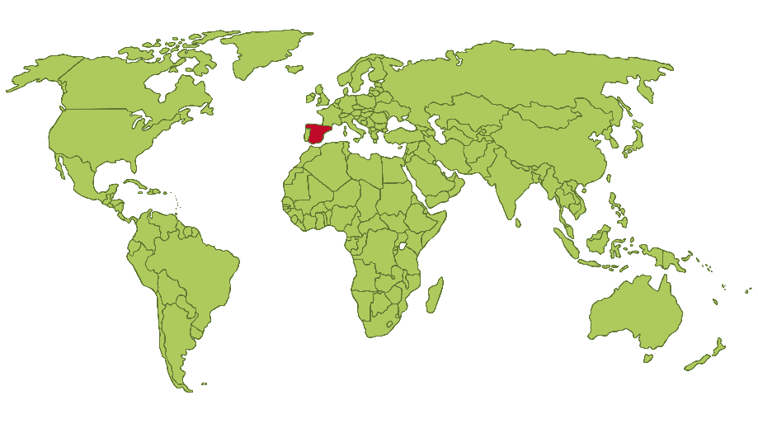
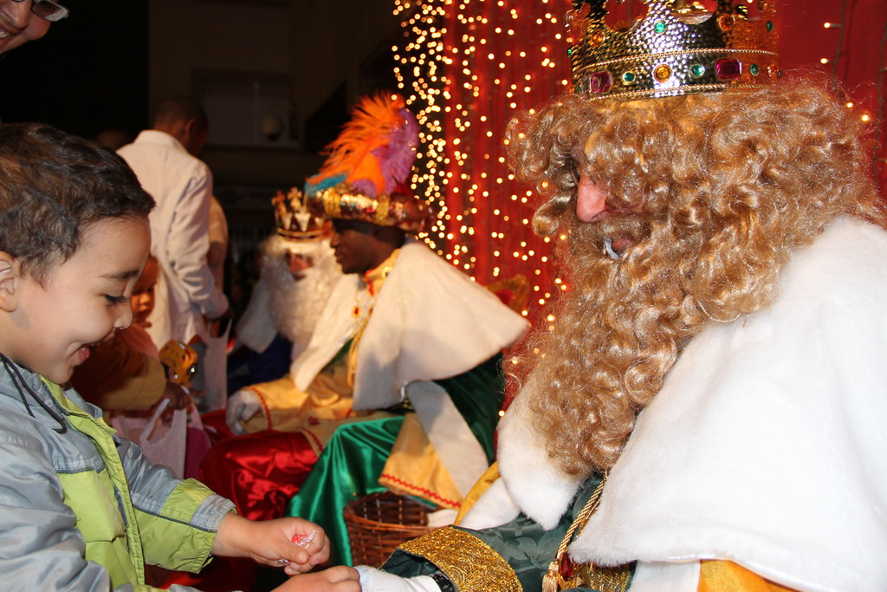
7
On the evening of 5th January, the eve of the day that Christians believe the wise men brought gifts to baby Jesus, Spanish towns and cities hold parades for ‘Dia de los Reyes’, or ‘Kings’ Day’. Mechanical floats or people playing the parts of the wise men throw sweets out into the crowds for the children.
The parade is in the early evening to give children time to go home, leave a cleaned pair of shoes outside and go to bed to wait for the wise men to return with gifts - or coal - in the night.
The next day, families might tuck into a Roscon de Reyes. This sweet bread with lots of sugar and dried fruit has a little plastic king or queen hidden in it and whoever finds it is monarch for the day. If you find a bean, though, it’s your turn to buy the Roscon
next time!
Back to Calendar

Slide 10
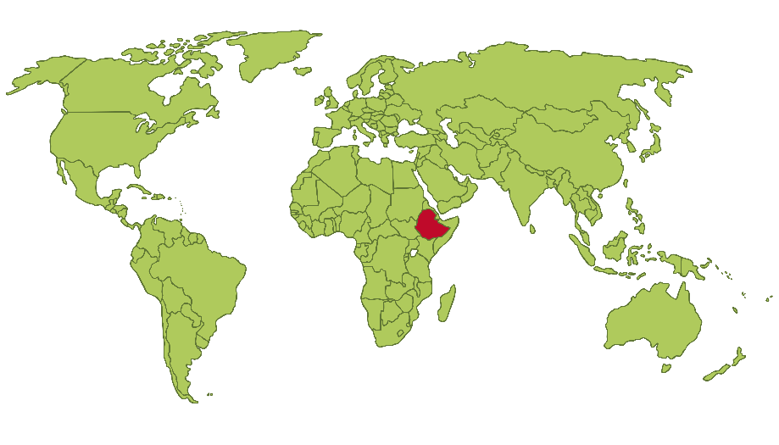
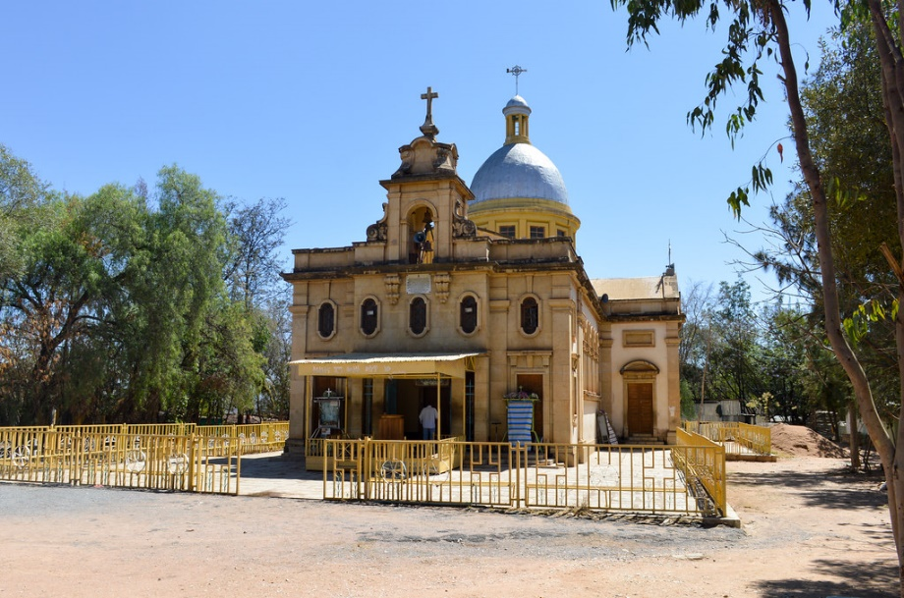
8
In Ethiopia, Christmas Day is celebrated on 7th January. The celebration is called ‘Ganna’ or ‘Genna’ and most people go to church on Christmas Day.
For 43 days before Christmas, starting on 24th November, many people will also take part in a festive fast called the Tsome Nebiyat or ‘Fast of the Prophets’. They will eat one vegan meal each day as meat, dairy, eggs and wine are not allowed during the fast.
“Selassie Church” by Francisco Anzola is licensed under CC BY 2.0
Back to Calendar

Slide 11

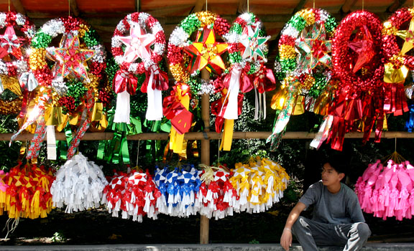
9
One tradition in the Philippines is the ‘parol’. This is a bamboo pole or frame that then has a lantern placed on it in the shape of a star. Traditionally, these are made with bamboo strips and Japanese paper and is made to represent the star that led the three wise men.
Christians might go to church for Christmas Eve mass followed by Noche Buena - a midnight feast. Friends, family and neighbours stop by to wish each other a Merry Christmas while big dishes are laid out for everyone to tuck into.
“Lanterns, anyone?” by Keith Bacongco is licensed under CC BY 2.0
Back to Calendar

Slide 12
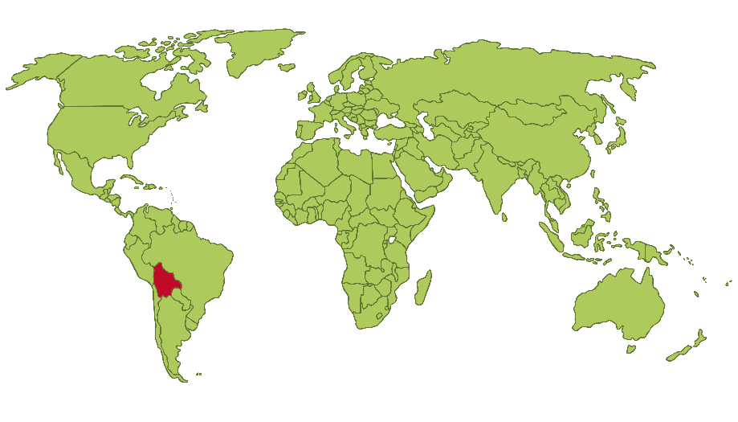
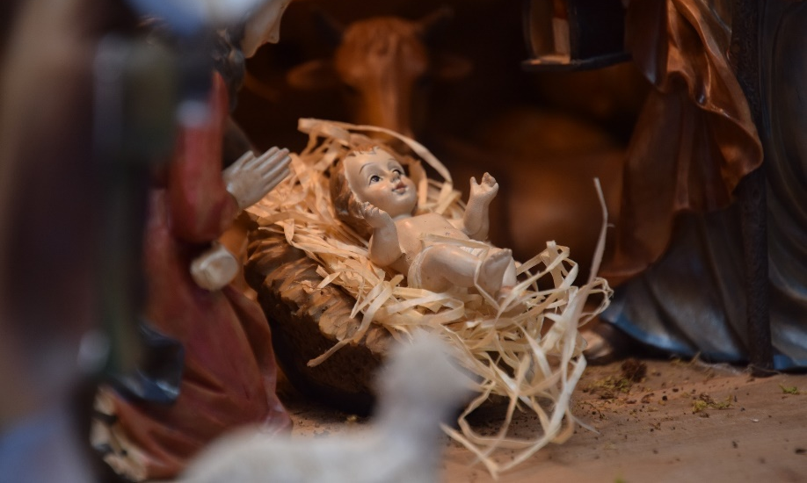
10
Christmas Eve is the most important time of the festive season in Bolivia. Families go to a special midnight mass service called ‘Misa del Gallo’, or ‘Mass of the Rooster’. It’s called this because locals get home in the early hours of the morning, around the same time that the rooster calls.
At mass, people bring two offerings: a small figurine of baby Jesus, and something to represent their job, such as a chef bringing a wooden spoon.
Back to Calendar

Slide 13
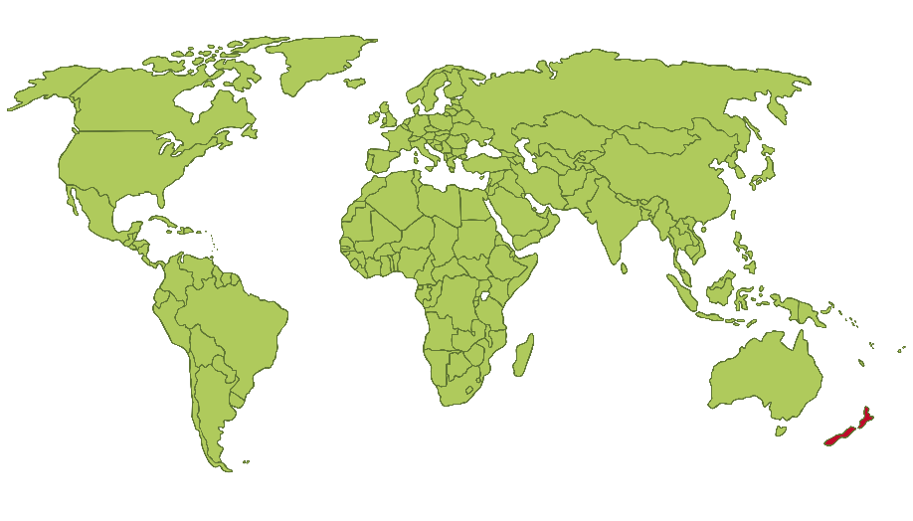
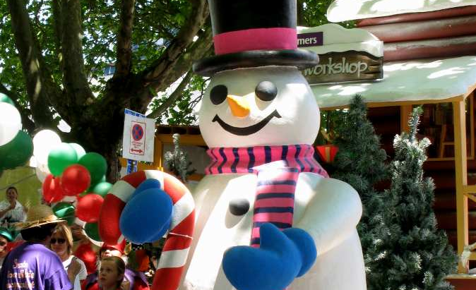
11
Many towns in New Zealand have a Santa parade from mid-November with local businesses and churches decorating floats for the parade. There will also be bands and marching teams. As Christmas falls during the summer in New Zealand, Santa may be seen wearing a pair of sandals and swapping his red coat for a New Zealand rugby shirt.
Children leave out carrots for the reindeer and Santa may find a beer and some pineapple chunks when he visits.
“Snowman” by Eric Bréchemier is licensed under CC BY 2.0
Back to Calendar

Slide 14

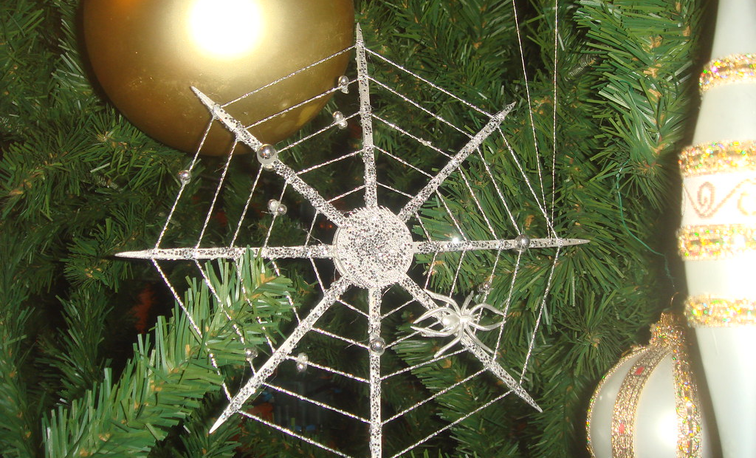
12
Some Ukranians believe in the story of the widow whose children were excited to decorate a tree for Christmas. The poor widow knew they could not afford to decorate the tree and so the children went to bed on Christmas Eve sobbing.
The house’s spiders heard the children crying and so spun a series of webs all over the tree. One version of the story says the next morning, the sunlight turned each web into silver and gold and the family were no longer poor.
It became traditional for Ukranians to decorate their Christmas trees with artificial spider webs to bring good luck and fortune.
“Ukranian Christmas Tree at the Museum of Science and Industry, 2008” by Daniel X. O-Neil is licensed under CC BY 2.0
Back to Calendar

Slide 15
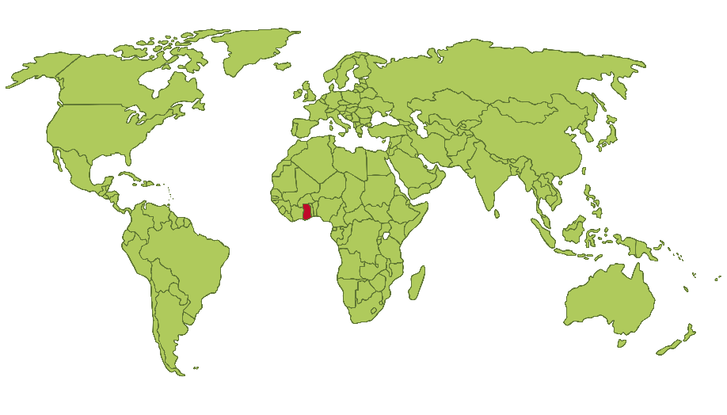
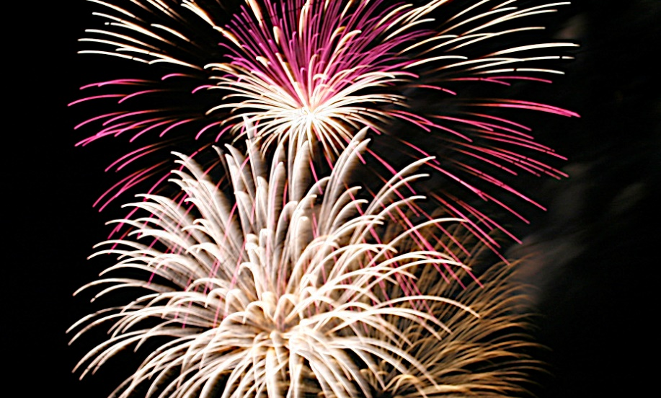
13
There are more than 60 languages spoken in Ghana and this diversity means that there are lots of different traditions at Christmas.
On Christmas Eve, some people go to church services filled with drumming and dancing. Children might perform a Nativity play. Choirs then sing and people dance in front of the priests. This can last all night!
Churches are filled on Christmas Day before families return home to exchange gifts.
Back to Calendar

Slide 16


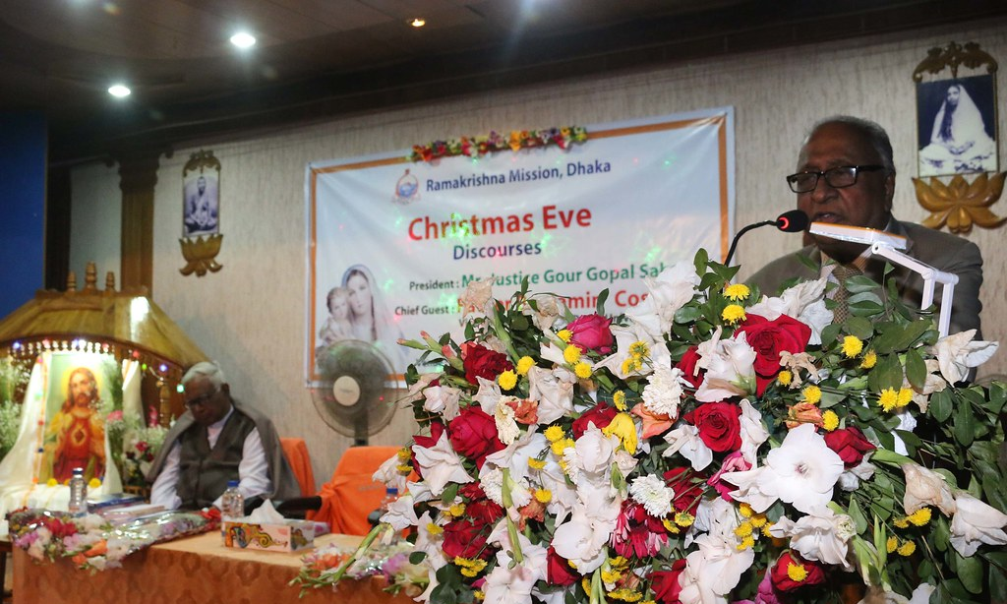
14
Even though only less that half a percent of the population are Christians, 25th December is a public holiday for Christmas in Bangladesh.
Big towns and cities may try to replicate a more western Christmas with fake snow and artificial Christmas trees, though Christmas trees and cards are becoming
more popular among Christians
in Bangladesh.
Christians may return to church to share the ‘Preeti-bhoj’ which means ‘love feast’.
Back to Calendar

Slide 17
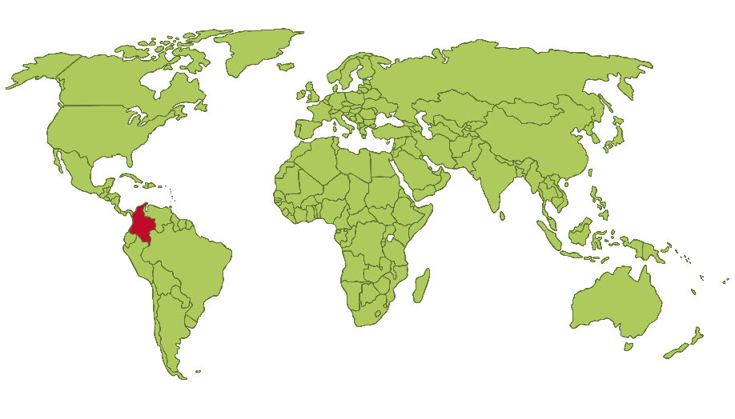
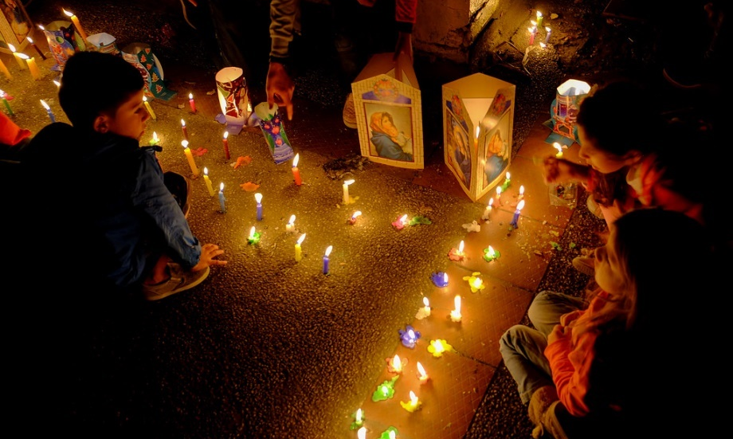
15
Christmas celebrations begin on 7th December with ‘Día de las Velitas’ or ‘Day of the Little Candles’. As the name suggests, lots of candles, lights and lanterns are used to decorate houses and there are often big fireworks with music and food to celebrate.
From 16th December to Christmas Eve, a lot of Colombians join in with ‘novenas’. This is a time when families, friends and neighbours join together to pray in the run up to Christmas.
On 28th December, Colombians celebrate Innocents Day which is filled with practical jokes and fun, similar to April Fools’ Day.
“Dia de lad Velitas 2016, Mosquera” by Reg Natarajan is licensed under CC BY 2.0
Back to Calendar

Slide 18
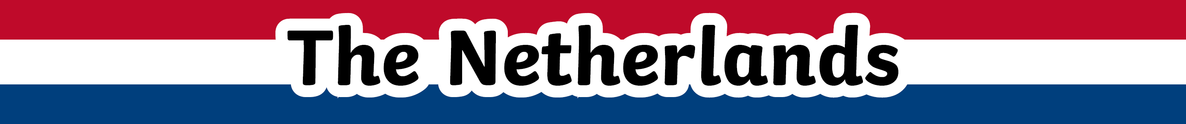

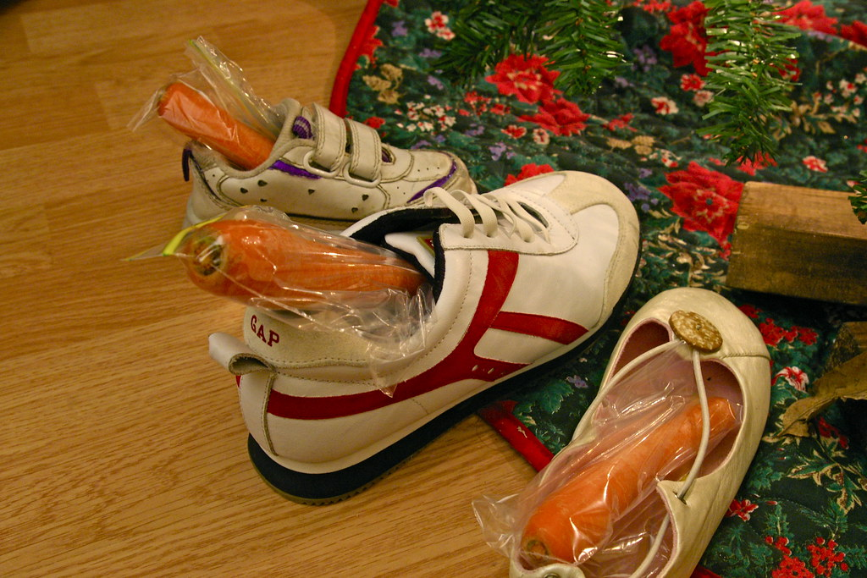
16
Every November, children and adults across the Netherlands wait to welcome Sinterklaas to the country. He arrives in a different city each year ahead of Pakjesavond, or
‘Gift Evening’.
This is celebrated on 5th December, the night before Sinterklaas’ birthday. Children sing Sinterklaas songs and place a shoe by the fire with a drawing for Sinterklaas and a carrot or hay for his horse.
When children wake up, they hope to find their drawings gone and sweets or gifts left in their shoes instead.
Back to Calendar

Slide 19
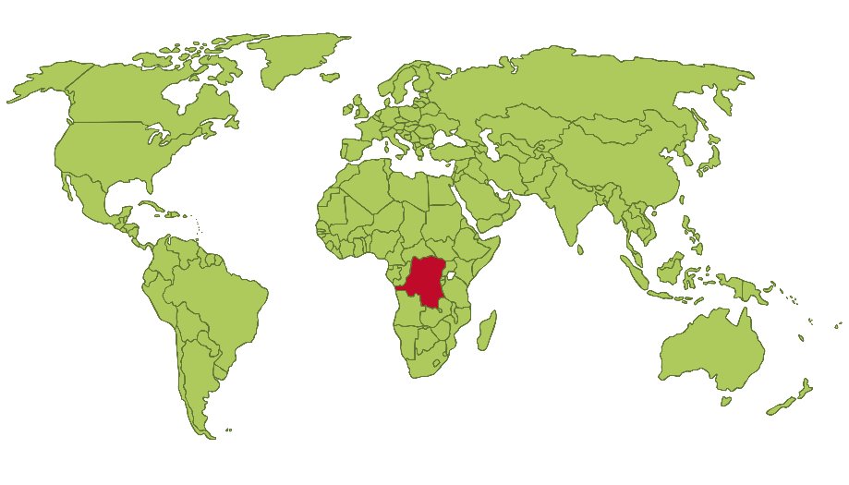
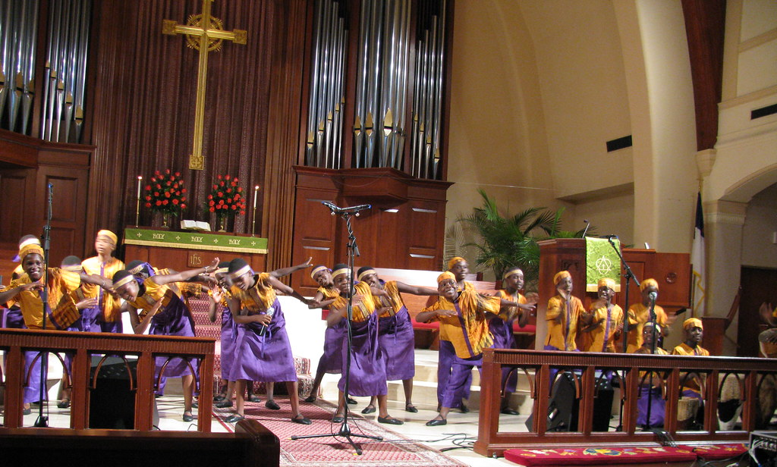
17
Many churches in the Democratic Republic of the Congo have 5 or 6 choirs who will all play their part in a big musical service held on Christmas Eve.
Nativity plays last a long time and cover the events from the very beginning of the Bible with the creation of Adam and Eve and go all the way through to stories much later in the Bible. Jesus’ birth is timed to happen as close to midnight as possible, with the play usually finishing at 1.00am.
Church-goers usually return for the Christmas Day service at around
9.00am the next morning.
“African Children Choir” by Mathieu Plourde is licensed under CC BY 2.0
Back to Calendar

Slide 20
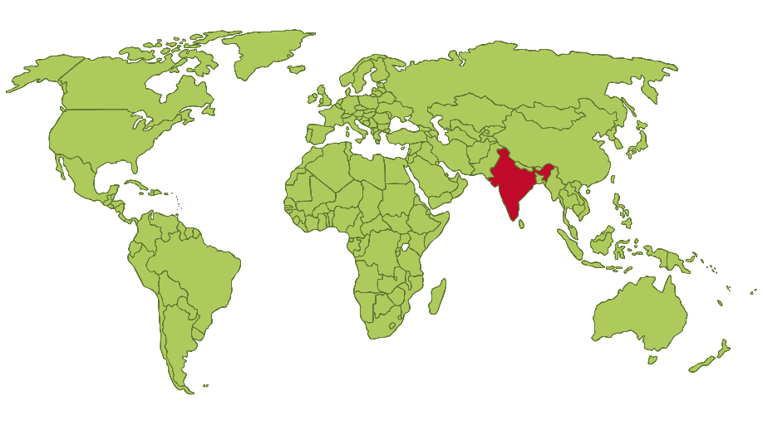
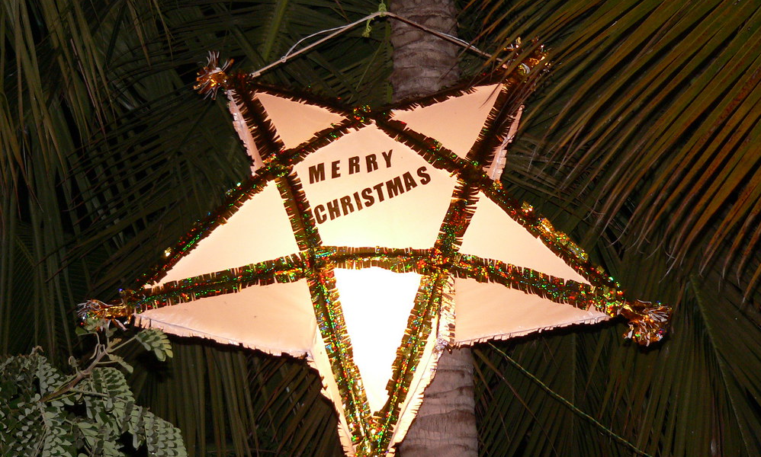
18
Christians in India may attend Midnight Mass at church. The entire family will walk together and afterwards they will share a large feast and exchange gifts.
Instead of traditional Christmas trees, Christians in India may instead decorate a banana tree or a mango tree, or hang mango leaves around their homes.
In southern India, you might also see oil lamps lit on the flat roofs of homes to represent that Jesus is the light of the world.
“Merry Christmas!” by Mikhail Esteves is licensed under CC BY 2.0
Back to Calendar

Slide 21

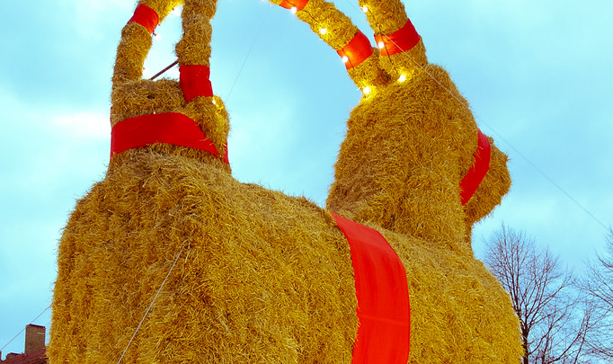
19
Every year, the town of Gävle builds the most famous of Sweden’s yule goats. On the first day of Advent, in late November or early December,
a goat is built out of straw, about
40 feet high.
Some Swedish people believe that the yule goat is an invisible spirit who appears to make sure that Christmas preparations were done correctly.
Some people prank their neighbours by hiding a straw goat in their house without them noticing, while others hang small straw goats on their Christmas tree.
“Bocken Again!” by Johan Hansson is licensed under CC BY 2.0
Back to Calendar

Slide 22
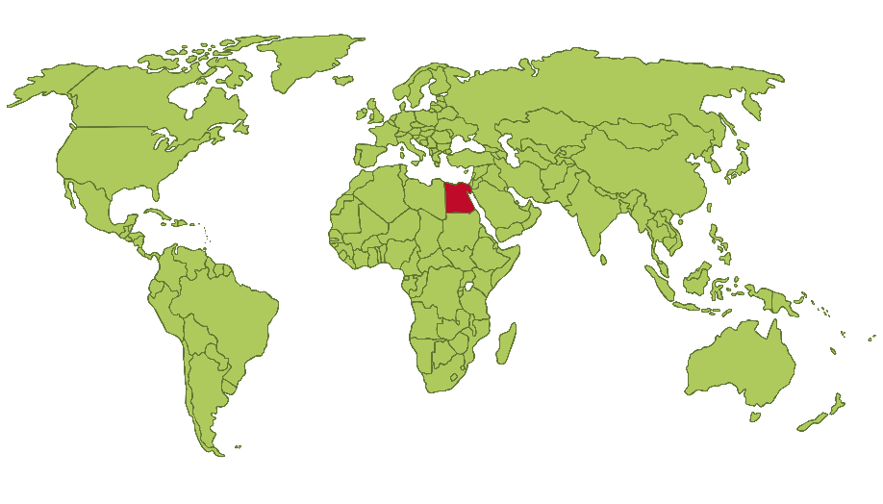
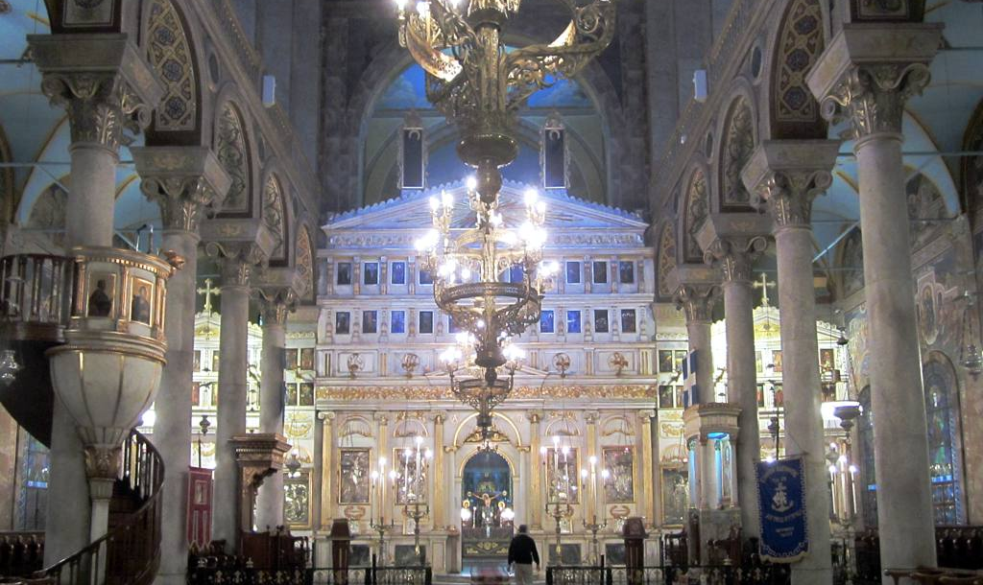
20
In Egypt, Santa is called Baba Noel and children might leave out some sweet biscuits called ‘kahk’ for him on Christmas Eve.
Christmas Eve is on 6th January and many people will go to church for services that start at around 10.30pm and can last until as late as 4.00am! As soon as families return home from church, they have their main Christmas meal - typically ‘Fata’, a soup containing bread, rice, garlic and
boiled lamb.
Christmas Day is celebrated on 7th January in Egypt. Families may meet for parties and gift each other biscuits.
“Church of Saint Sabbas” by David Stanley is licensed under CC BY 2.0
Back to Calendar

Slide 23

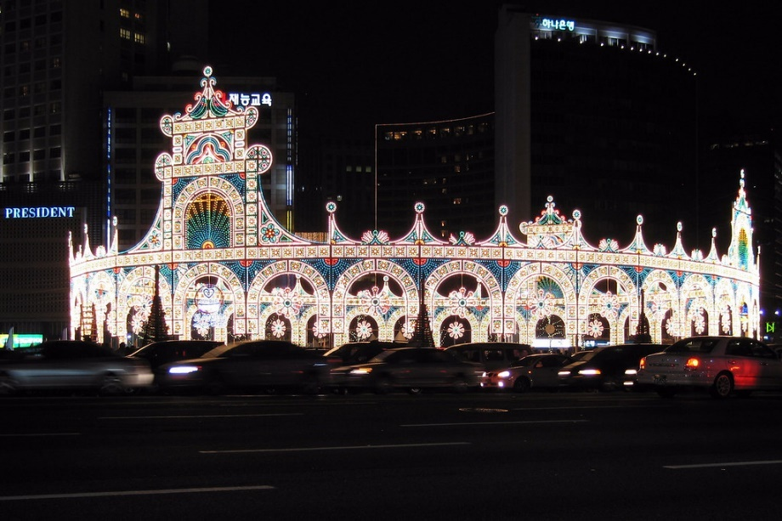
21
Christmas Day is an official holiday in South Korea so people get the day off
from work or school but they do have to go back the next day!
Attending church on Christmas Day is becoming more popular, even among
non-Christians, and people may exchange presents or gift money to loved ones. Unlike most countries, the holiday is celebrated more by couples rather than families.
Churches and department stores will be decorated with lots of lights. In the capital city of Seoul, lights are displayed all over the city centre including on the bridges over the Han River.
“Christmas Lights” by Andrew Currie is licensed under CC BY 2.0
Back to Calendar

Slide 24

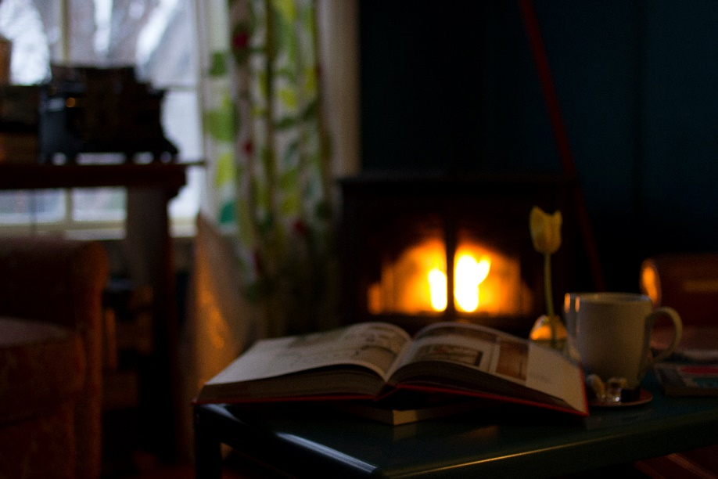
22
In Iceland, Christmas is
celebrated with a tradition called Jolabokaflod. This roughly translates as ‘the Christmas book flood’. On Christmas Eve, books are given as gifts and people read them straight away as they snuggle in front of the fire with some
hot chocolate.
The tradition began following the Second World War. Paper had not been rationed so books were a popular gift to give to loved ones.
Back to Calendar

Slide 25

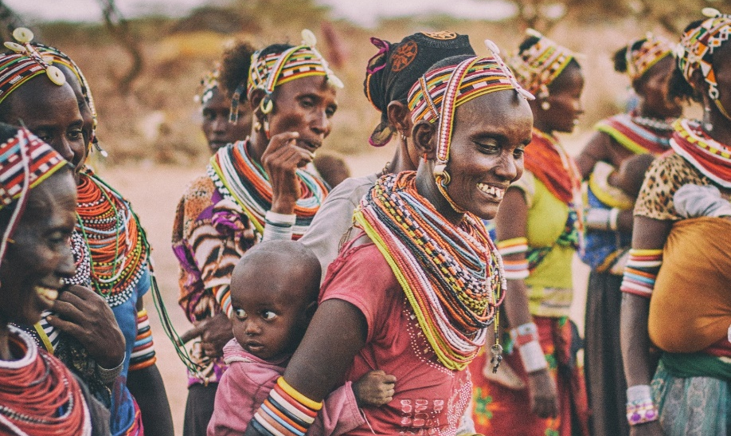
23
Just before Christmas, you may see many Kenyans leaving the big cities to return to the villages where their families live. Christmas is often a family time in Kenya and there are many celebrations, events and church services taking place both in the cities and rural areas.
Houses and churches are decorated with colourful balloons, paper decorations and ribbons. Some people may decorate a cypress tree or hang flowers and green leaves around
their home.
On Christmas Day, people may have
a barbecued meat served with rice
and chapati.
Back to Calendar

Slide 26


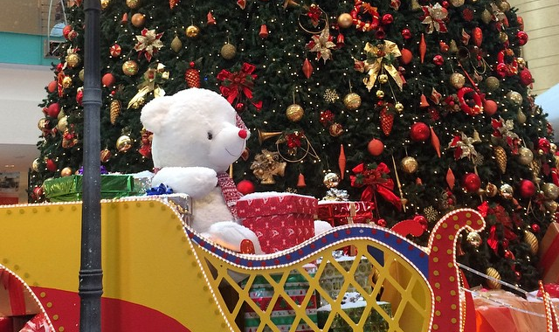
24
The United Arab Emirates is a predominantly Islamic country so Christmas is not generally celebrated.
The 25th December is not an official holiday but there are still lots of Christmas decorations to be seen in hotels, shops and shopping centres mainly to be enjoyed by the many tourists and those who have moved from other countries.
In 2010, at a 5-star hotel in Abu Dhabi, you could see the world’s most expensive Christmas tree with decorations worth millions of dollars including diamonds
and rubies.
The UAE is already well-decorated in December as its national day is on the 2nd. Some places leave these decorations up
for Christmas.
“Christmas is in the air at Abu Dhabi Mall” by Thomas Galvez is licensed under CC BY 2.0
Back to Calendar

Slide 27

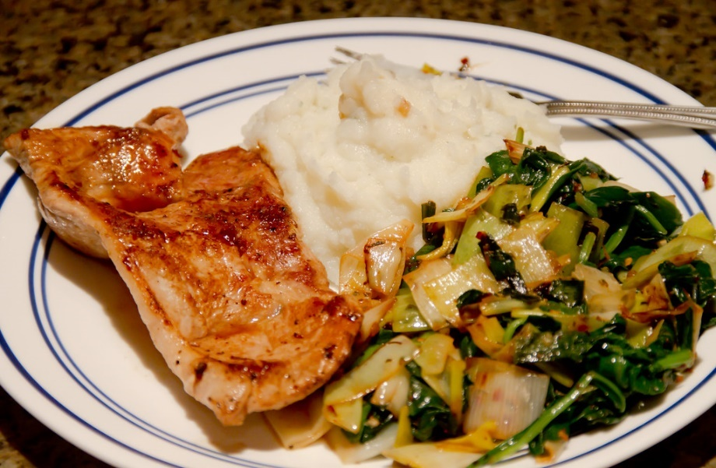
25
In Finland, you may see farmers hanging wheat sheafs, nuts
and suet from their trees to
give the birds their own little
Christmas treat.
In the north of the country, there is a large theme park called ‘Christmas Land’. This is said to be near to where Santa lives.
Christmas Day is a quiet family day and people might meet up again on Boxing Day.
“Pork chops with mashed potatoes and cooked spinach” by Razvan Orendovici is licensed under CC BY 2.0
Back to Calendar

